Slide 1
Cirrhosis:
Liver transplant
NARVAEZ CAO ROMERO ALDO

Slide 2
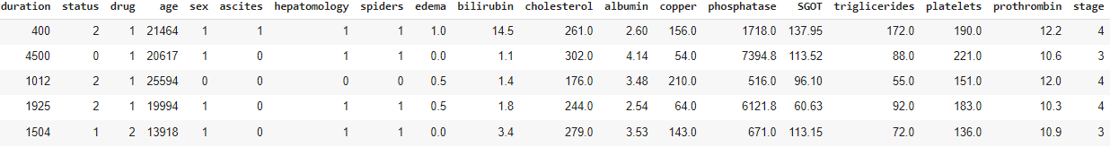
The goal of this project is taking as target the variable Status, and use it to predict if a person is candidate to receive a transplant or not
There was a total of 312 rows and 20 columns

Slide 3
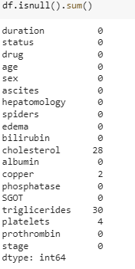
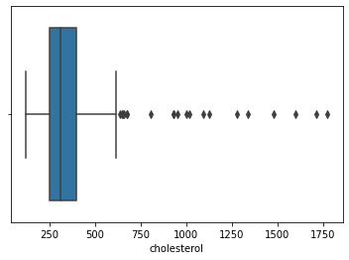
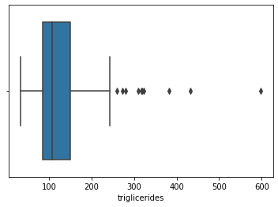
Cleaning and EDA
Get rid off null values
Replace the cholesterol and the triglycerides for their median and mean values
Eliminate the rest of the Null

Slide 4
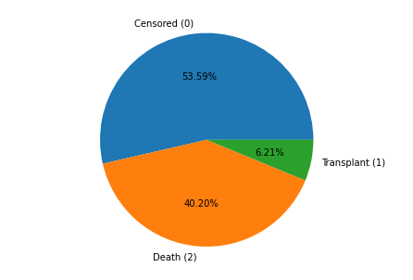
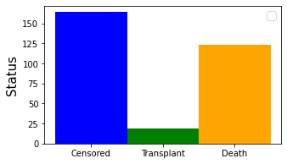
Taking a look to the target

Slide 5
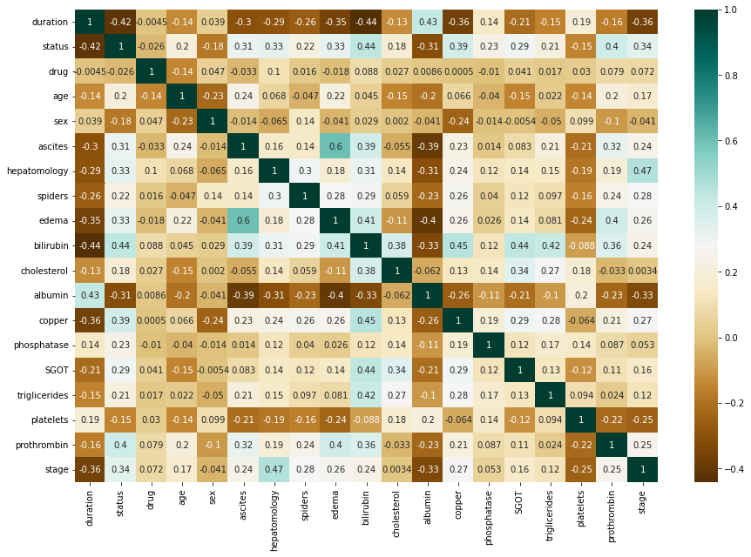

Slide 6
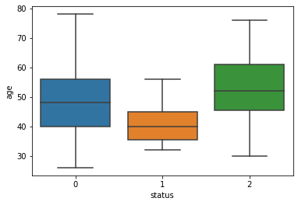
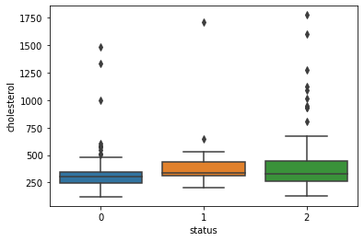
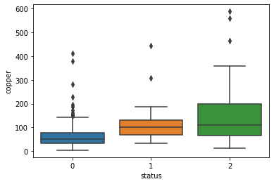
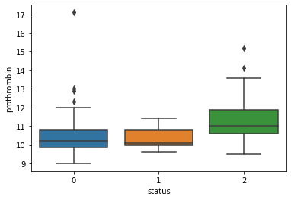

Slide 7
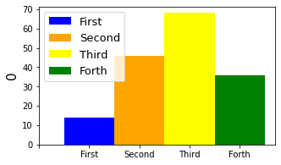
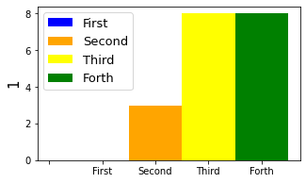
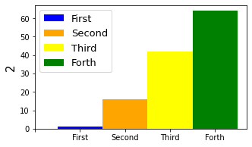

Slide 8
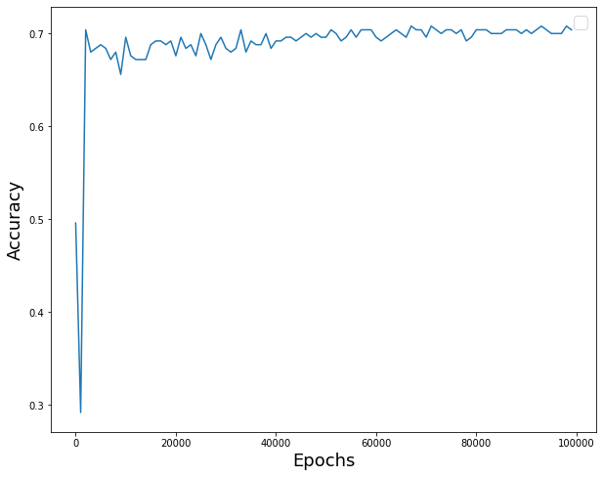
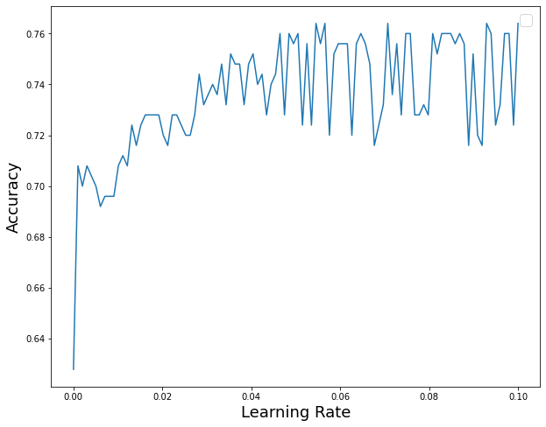
Training the model
It was used the Shallow ANN algorithm, and it was trained with 85% of the data. Along with the columns : hepatomology, copper, ascites, edema, bilirubin, albumin and prothrombin

Slide 9
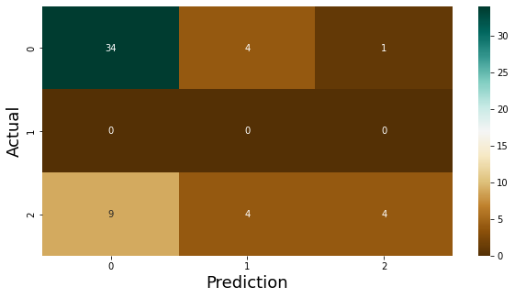
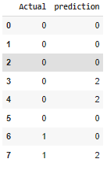
It was obtained an accuracy of 72% for the Training data and 68% for the test data

Slide 10
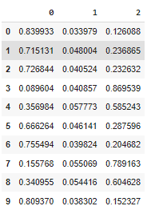
We didn’t get the best results. Let’s take a look to the probabilities

Slide 11
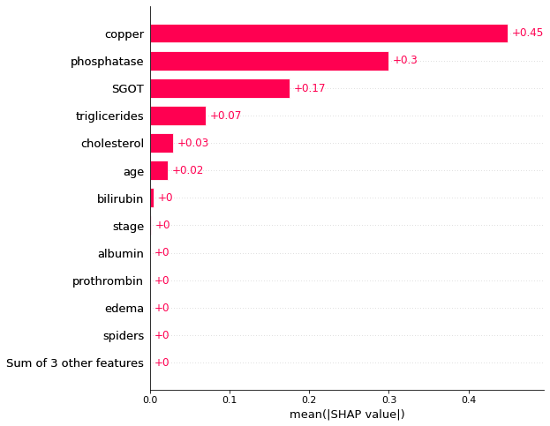
Additional remarks
What is the effect of each variable in our model

Slide 12
Conclusions
It was found really interesting relations between the status target and some other variables during the EDA
It was understood, by observing the confusion matrix and the probabilities dataframe, why the accuracy of the model was not very precise. We can be able of getting a better one by increasing the amount of essays.
We were able to observe which variables are the ones which has more impact in our model

Slide 13
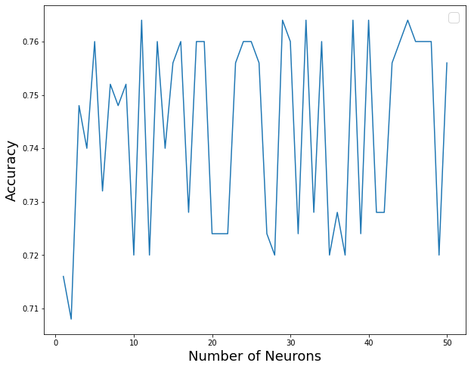
Appendix

Slide 14

